Slide 1


Individual Differences in Word Learning Symposium
An Investigation Into How Word Learning Modality & Phonological Skills Support Word Learning & Subsequent Reading
SARAH S. HUGHES-BERHEIM
sarah.hughes-berheim@vanderbilt.edu
SSSR, July 2024
Notes:
Add slides online
Indicate paper is under review

Slide 2

VOCABULARY
IS IMPORTANT FOR READING
01
Lexical Quality Hypothesis
Vocabulary deficits can result in poor RC (Perfetti & Hart, 2002)
98%
TEXT COVERAGE
02
Lexical Threshold for Reading
For RC, need to know 98% of words in text (Hu & Nation, 2000 & Schmitt et al., 2017)
~ 8,500
03
Necessary Vocabulary Size
VOCAB WORDS
8,000-9,000 word families (Nation, 2006)
Notes:
Perfetti, C. A., & Hart, L. (2002). The lexical quality hypothesis. In Precursors of Functional Literacy (pp. 189–213). https://doi.org/10.1075/swll.11.14per

Slide 3

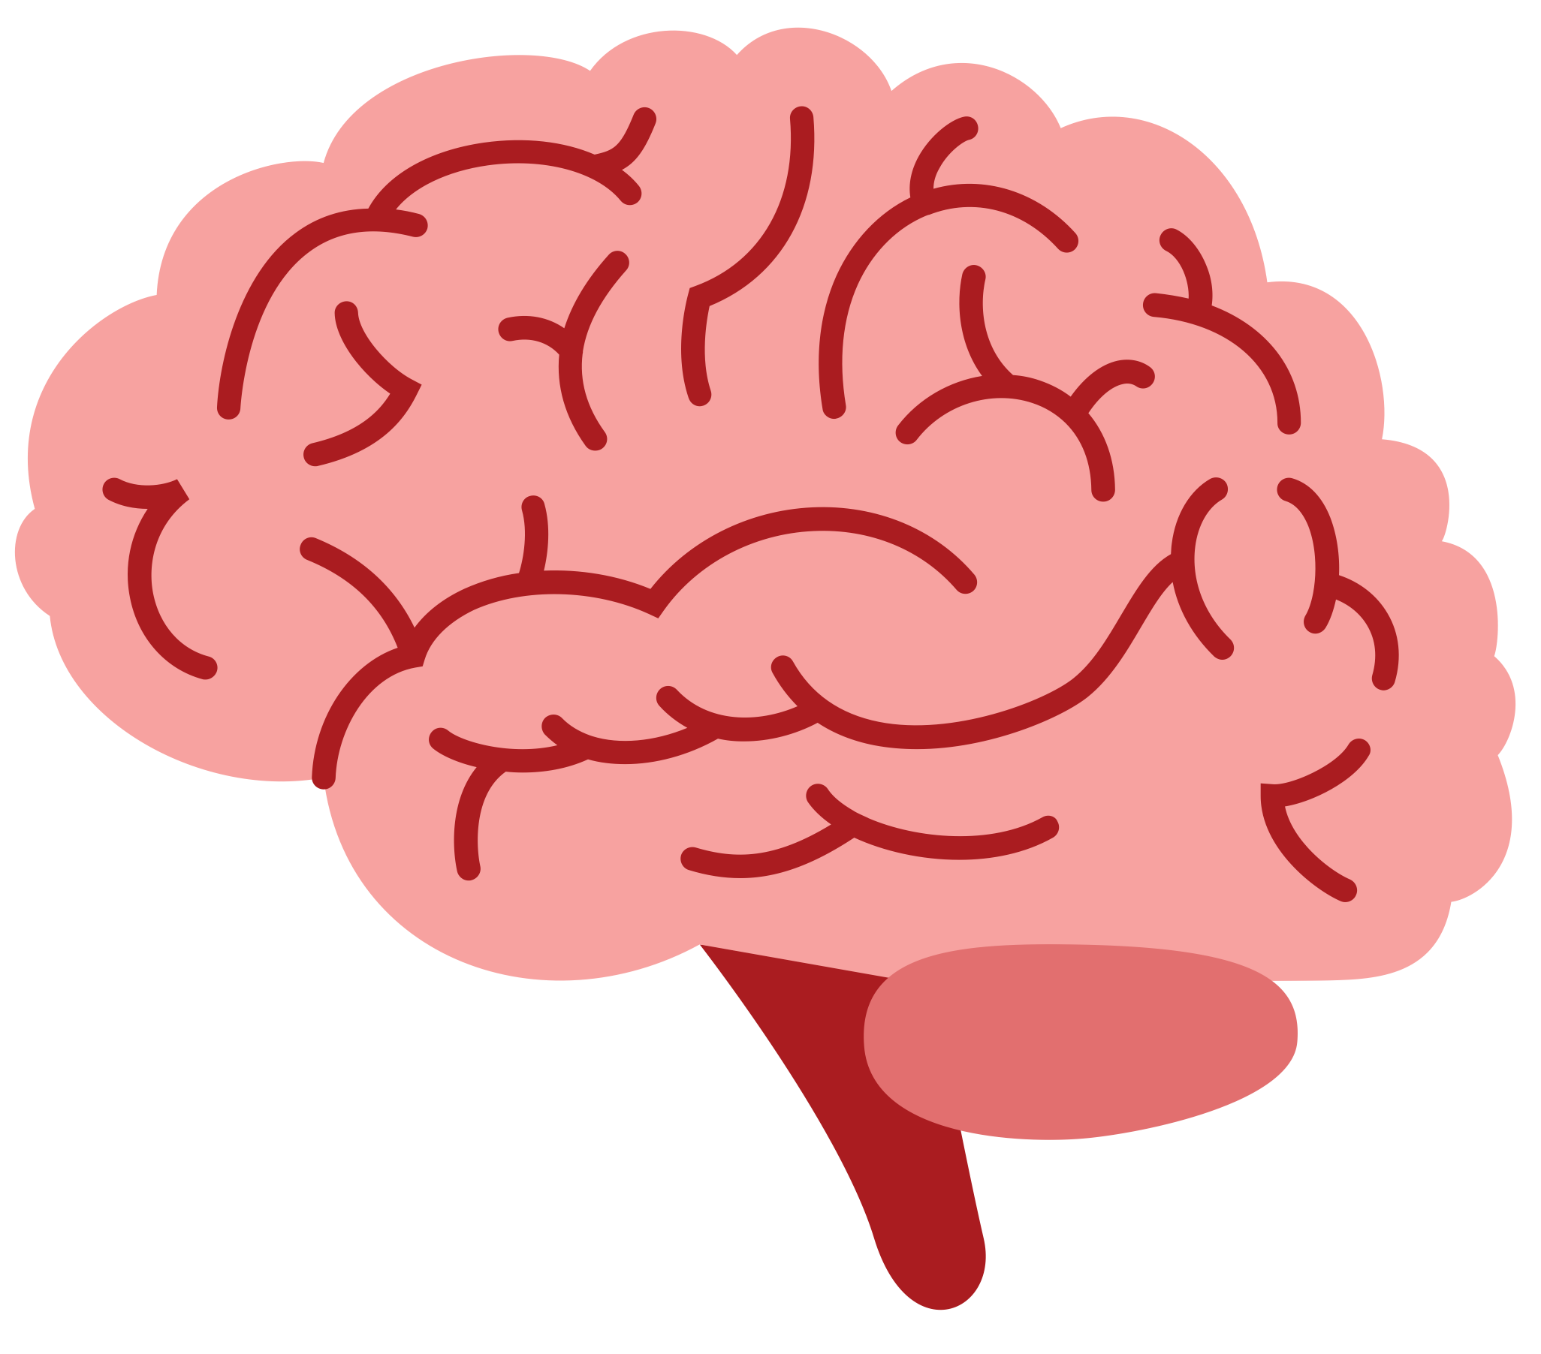


HOW WE
LEARN VOCABULARY
Word Experience Model
lacuna
Words are learned via our interactions (Reichle & Perfetti, 2003)
Each word encounter creates a unique lexical representation based on available word features
Lexical representations are strengthened over repeated encounters → lexicalization
[luh-kyoo-nuh]
 | orthography → meaning
 | phonology → meaning

Slide 4
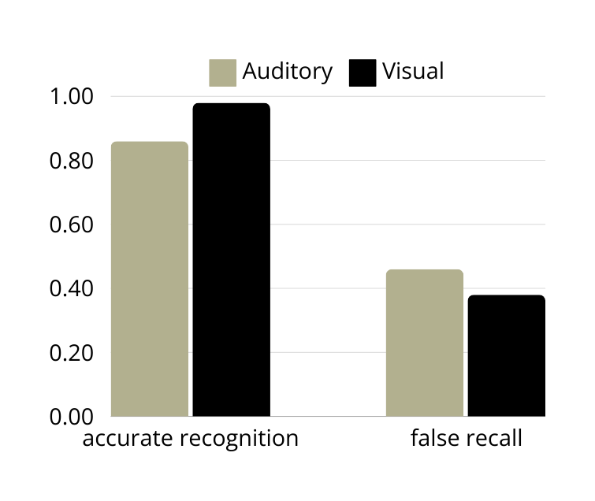
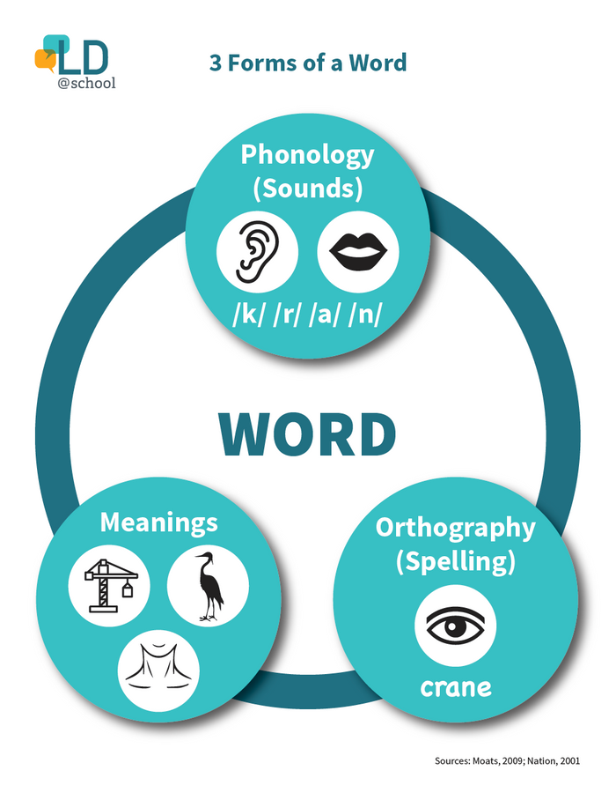
FACTORS AFFECTING
*
WORD LEARNING
MODALITY
*
visual word learning advantage in visual recognition (Nelson et al., 2005) and in recall (Gallo et al. 2001)
Figure adapted from Nelson et al., 2005 & Galo et al., 2001
INDIVIDUAL DIFFERENCES
reading comprehension ability aids word learning (Balass et al, 2010; Perfetti, 2007)
phonological skills aid word learning (for review see Meade, 2020)
individuals create cross-modal traces
Notes:
Perfetti, C. A. (2007). Reading ability: Lexical quality to comprehension. Scientific Studies of Reading, 11(4), 357–383.
Nelson, J. R., Balass, M., & Perfetti, C. A. (2005). Differences between written and spoken input in learning new words. Written Language & Literacy, 8(2), 25–44.
Gallo, D. A., McDermott, K. B., Percer, J. M., & Roediger, H. L. (2001). Modality effects in false recall and false recognition. Journal of Experimental Psychology: Learning Memory and Cognition, 27(2), 339–353.
Balass, M., Nelson, J. R., & Perfetti, C. A. (2010). Word learning: An ERP investigation of word experience effects on recognition and word processing. Contemporary Educational Psychology, 35(2), 126–140.
Meade, G. (2020). The role of phonology during visual word learning in adults: An integrative review. Psychonomic Bulletin & Review 2020 27:1, 27(1), 15–23.

Slide 5
Confirm modality effect
RESEARCH QUESTIONS:
Visual vs. auditory word learning
HOW DO THESE WORD LEARNING FACTORS AFFECT SUBSEQENT WORD READING?
Test individual diferences
Phonological Skills (decoding & recoding)
Reading Comprehension
Investigate interaction between modality and skills
Modality x Phonological Skills
Modality x Reading Comprehension

Slide 6
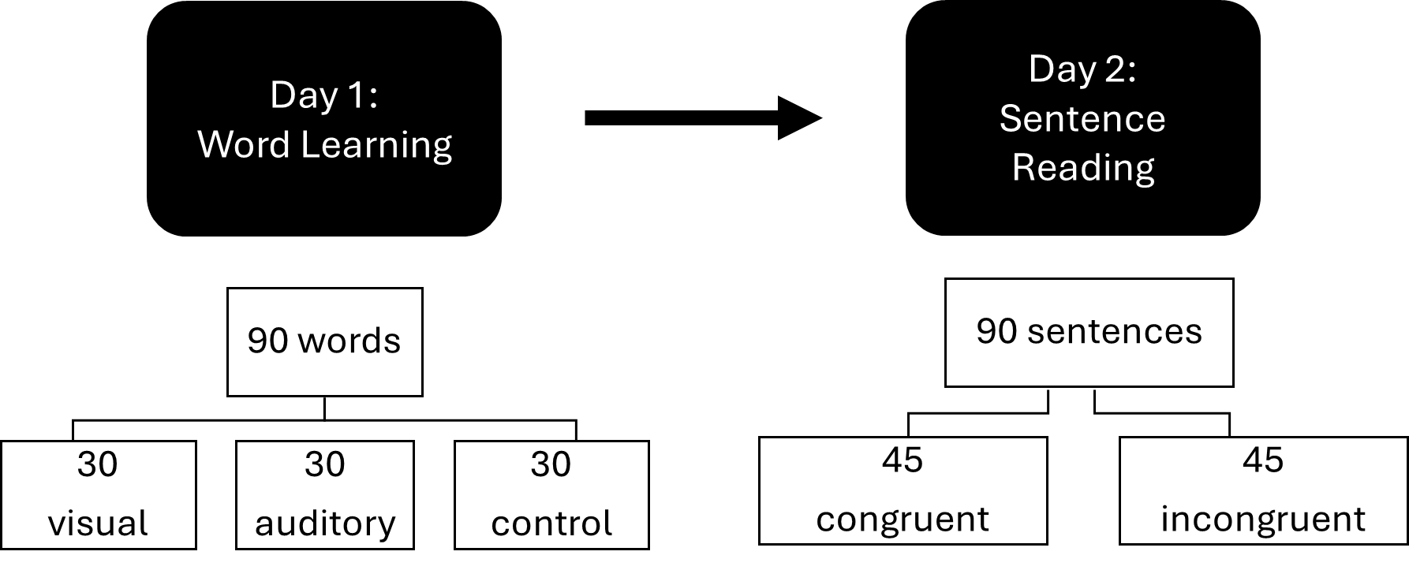
METHOD: STUDY DESIGN
WITHIN GROUPS STUDY (N = 26 [M AGE = 20.4, SD = 2.61])
SCQ: Did the meaning of the word match the context of the sentence?
Stimuli were used in 2 previous studies
(Balass et al., 2010 & Elgort et al., 2015)
Notes:
Say no meaning was learned in control just to briefly describe

Slide 7

METHOD
WORD LEARNING AND SENTENCE READING
lacuna
lacuna
Visual
Auditory
Control
Definition
Context Sent.
Definition
Context Sent.
+
Her
Sentence Reading
+
argument
....
lacuna.
SCQ
Yes No
350 ms
350 ms
1000 ms
Notes:
Presented this way because EEG

Slide 8


METHOD
INDIVIDUAL DIFFERENCE MEASURES
01
Comprehension: NDRT
Nelson Denny Reading Test (15 min)
Score = Questions right out of 36 total
1/5 point deducted for incorrect or unanswered questions
(Brown, 1960)
02
Decoding: TOWRE PDE
03
Recoding: Spelling Dictation Test
Phonological Decoding Subtest
Score = Correct pronunciations in 45s
(Torgessen et al., 1999)
Phonological Recoding
Score = Correctly spelled out of 20
Not Timed
(Andrews & Hersch, 2010)

Slide 9

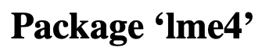
METHOD
MODELING
Linear Mixed Effect Modeling for Accuracy and Reaction Time on SCQ
Tested random effects of participant and item (word) using data-driven approach (Matushek et al., 2017)
Model fit was determined by the maximal random effect structure
Non-significant interaction terms were dropped

Slide 10
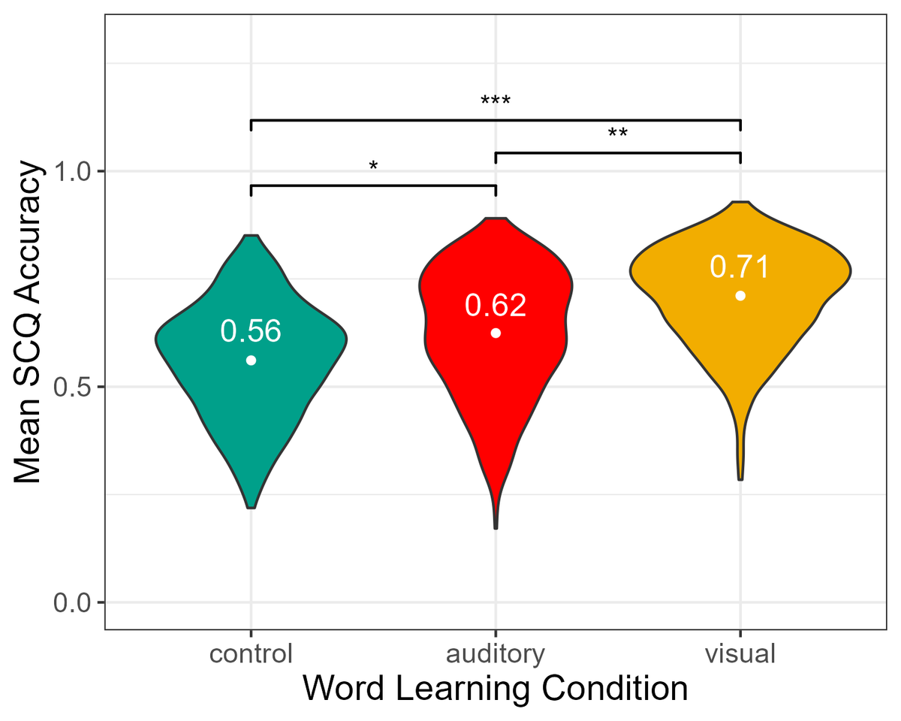
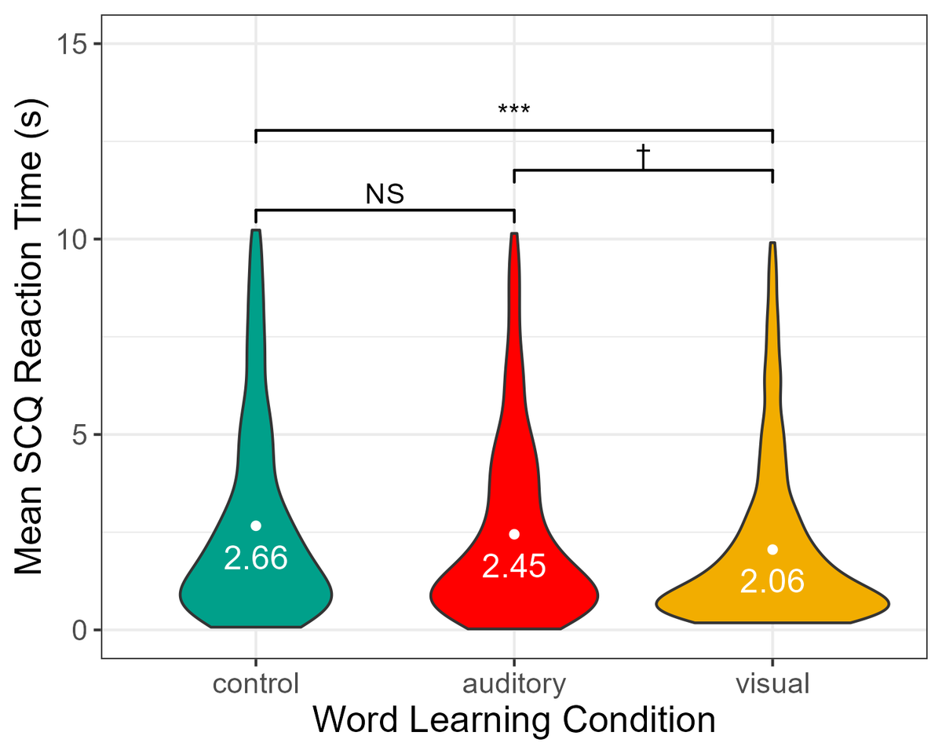
RESULTS
CONFIRMING THE VISUAL WORD LEARNING ADVANTAGE
QUESTION 1:
Accuracy
Reaction Time

Slide 11
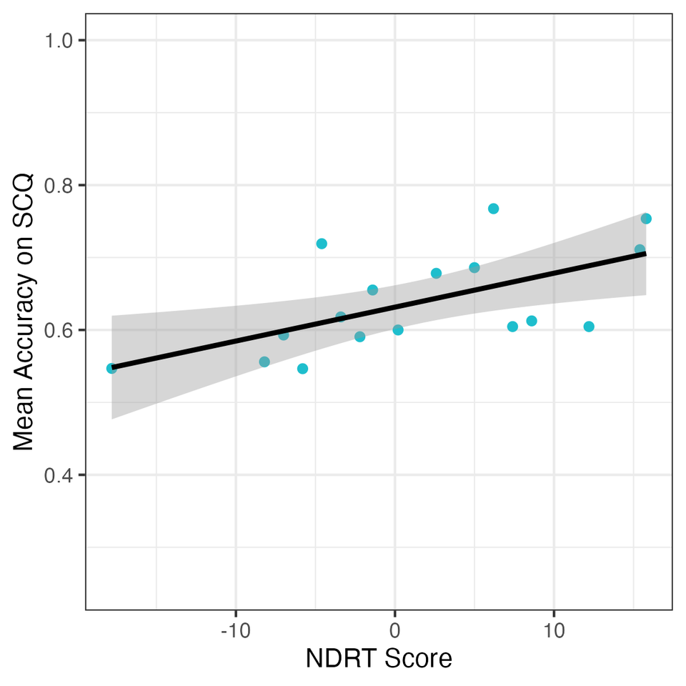


DO PHONOLOGICAL OR COMPREHENSION SKILLS AID WORD LEARNING AND READING
QUESTION 2:
Accuracy
Reaction Time
Comprehension (NDRT)
Decoding (TOWRE)
Recoding (Spelling)
(β = 0.02, SE = 0.01, z = 2.72, p = .007)

Slide 12
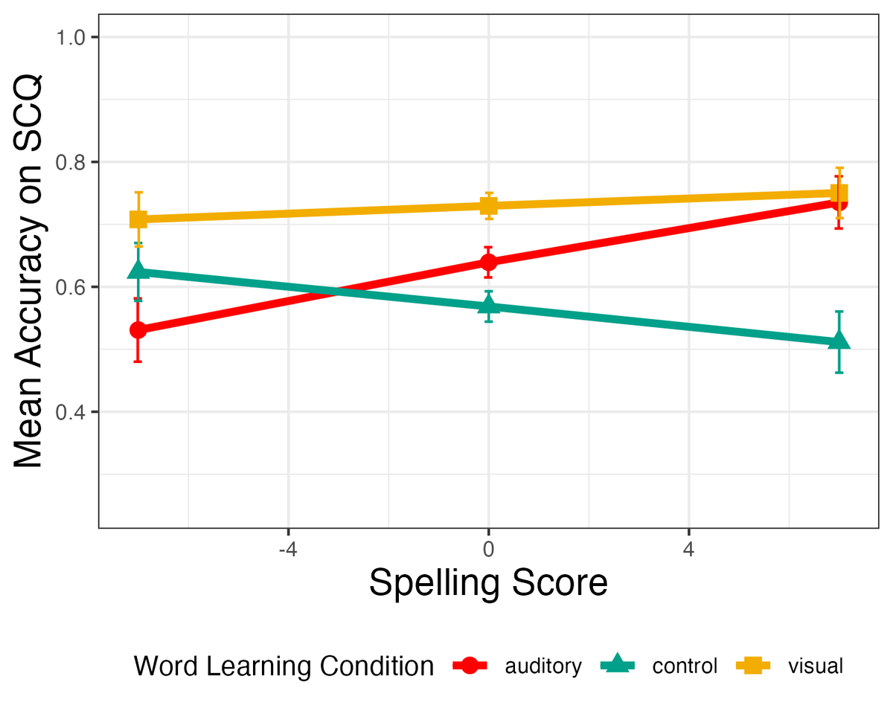
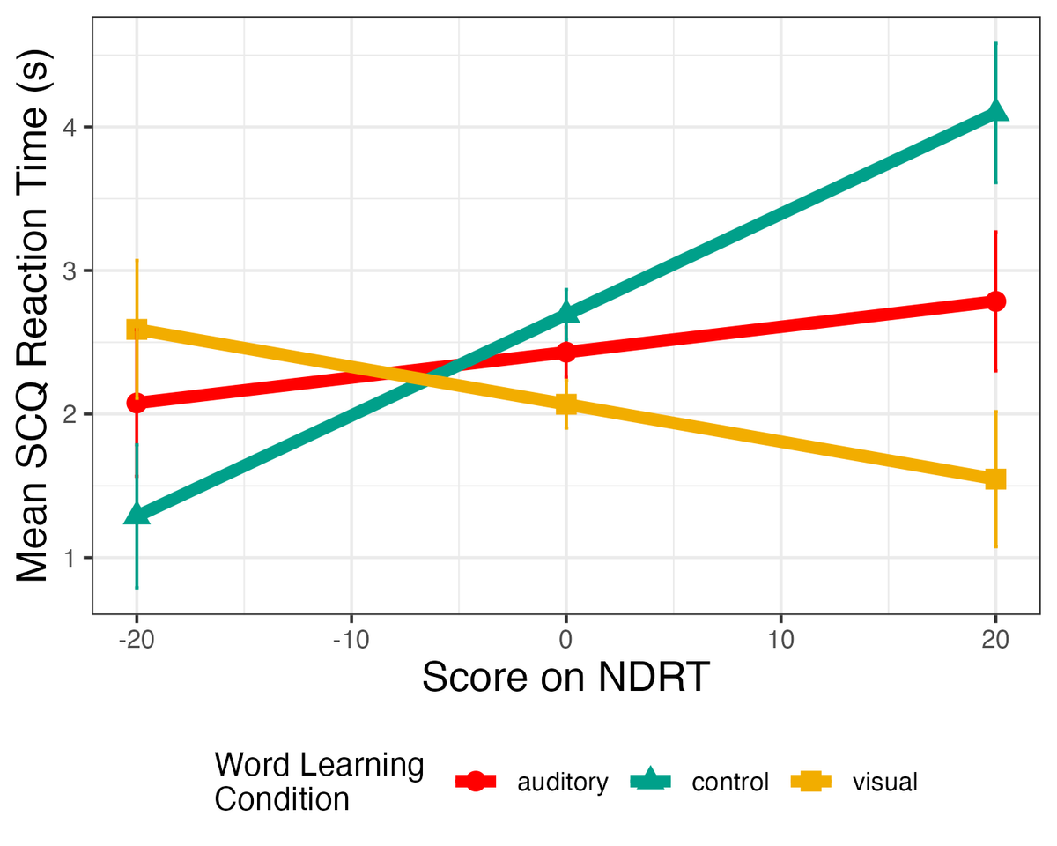
DO INDIVIDUAL DIFFERENCES INTERACT WITH MODALITY TO SUPPORT WORD LEARNING & READING
QUESTION 3:
Accuracy
Reaction Time
Notes:
One way to interpret this is that the poor and average readers did not show a modality effect. Another though is that only the good readers showed a modality effect which could be due to the fact that only the good readers could do the task. This fits with the results from question one that show a main effect of modality plus the results from question two that indicate good readers did better at the task.

Slide 13




SUMMARY
OF RESULTS
“Lacuna”
Lacuna
[luh-kyoo-nuh]
Words Learned Visually are More Accurately & Quickly Identified
Better Readers More Accurately Identify Learned Words
Strong Recorders Showed No Modality Effect
Learning words visually enhances subsequent word identification accuracy and RT during reading.
Only comprehension scores on the NDRT significantly predicted subsequent word identification accuracy during reading.
Individuals with high spelling test scores had similar accuracy for visually and auditorily learned words, low spellers did not.

Slide 14
CONCLUSION
MAIN TAKEAWAYS
LIMITATIONS
Visual word learning aids subsequent word reading
- especially for poor phonological recoders
Strong readers are better vocabulary learners
Phonological recoding should be practiced to enhance vocabulary learning across modalities
Difficult Task – maybe only good readers could do it?
Limited power (Brysbaert & Stevens, 2018)
FUTURE DIRECTIONS
Test in children
classroom setting
Test auditory sentence comprehension
Notes:
Conclusions – bring back to classroom and what does this mean for word learning (take back to importance of vocab)

Slide 15


ACKNOWLEDGEMENTS
Neuroscience in Education Research on Development Lab
Dr. Laura Morett
Education and Brain Sciences Research Lab
Dr. Laurie Cutting
Dissertation Committee:
Jack Shelley-Tremblay, University of South Alabama
Sharlene Newman, University of Alabama
Jason Scofield, University of Alabama
Spyridoula Cheimariou, Xavier University
Notes:
Look into vocab – are the good readers really building off their previous vocabulary?
Look into Spelling Test – what are the words and how did they choose them?

Slide 16
Intercorrelations for all Individual Difference and Behavioral Measures
 | TOWRE | Spelling | Reading Span | NDRT | SCQ accuracy | SCQ RT
TOWRE | - | - 0.18 *** | 0.27 *** | 0.15 *** | 0.05 * | 0.13 ***
Spelling |  | - | 0.37 *** | 0.33 *** | 0.05* | 0.08 *
Reading Span |  |  | - | 0.40 *** | 0.08** | 0.09 ***
NDRT |  |  |  | - | 0.09 *** | 0.11 ***
Note. TOWRE = Phonological Decoding Efficiency Subtest of the Test of Word Reading Efficiency; Spelling = Spelling Dictation Task; NDRT = Nelson-Denny Reading Comprehension Test; SCQ Accuracy = Accuracy on Semantic Congruency Question; SCQ RT = Reaction Time on Semantic Congruency Question. Values are Pearson’s correlation coefficient (r). * p < .05, ** p < .01, *** p < .001.

Slide 17
Mean Scores on Individual Differences and Behavioral Measures
 | M (SD) | Median [Min, Max]
TOWRE | 42.80 (8.74) | 42.50 [29.0, 65.00]
Spelling | 11.00 (3.67) | 11.00 [3.00, 18.00]
Reading Span | 2.50 (0.59) | 2.00 [2.00, 4.00]
NDRT | 19.20 (8.31) | 17.20 [1.20, 34.8]
SCQ Accuracy | 0.63 (0.07) | 0.61 [0.47, 0.77]
SCQ RT (ms) | 2349.36 (755.56) | 2467.70 [790.27, 3233.52]
Note. TOWRE = Phonological Decoding Efficiency Subtest of the Test of Word Reading Efficiency; Spelling = Spelling Dictation Task; NDRT = Nelson-Denny Reading Comprehension Test. SCQ Accuracy = Accuracy on Semantic Congruency Question; SCQ RT = Reaction Time on Semantic Congruency Question in seconds

Slide 18
SOURCES
Andrews, S., & Hersch, J. (2010). Lexical precision in skilled readers: Individual differences in masked neighbor priming. Journal of Experimental Psychology: General, 139(2), 299–318.
Balass, M., Nelson, J. R., & Perfetti, C. A. (2010). Word learning: An ERP investigation of word experience effects on recognition and word processing. Contemporary Educational Psychology, 35(2), 126–140.
Brown, J. L. (1960). The Nelson-Denny reading test. Houghton Mifflin Company.
Brysbaert, M & Stevens, M. (2018). Power analysis and effect size in mixed effect models: A tutorial. Journal of Cognition, 1(1) 1-20.
Gallo, D. A., McDermott, K. B., Percer, J. M., & Roediger, H. L. (2001). Modality effects in false recall and false recognition. Journal of Experimental Psychology: Learning Memory and Cognition, 27(2), 339–353.
Hu, M., & Nation, P. (2000). Unknown vocabulary density and reading comprehension. Reading in a Foreign Language, 13(2), 403–430.
Matuschek, H., Kliegl, R., Vasishth, S., Baayen, H., & Bates, D. (2017). Balancing Type I error and power in linear mixed models. Journal of Memory and Language, 94, 305–315.
Meade, G. (2020). The role of phonology during visual word learning in adults: An integrative review. Psychonomic Bulletin & Review 2020 27:1, 27(1), 15–23
Nation, I. S. P. (2006). How large a vocabulary is needed for reading and listening? The Canadian Modern Language Review, 63(1). 59-82.
Nelson, J. R., Balass, M., & Perfetti, C. A. (2005). Differences between written and spoken input in learning new words. Written Language & Literacy, 8(2), 25–44.
Perfetti, C. A. (2007). Reading ability: Lexical quality to comprehension. Scientific Studies of Reading, 11(4), 357–383.
Perfetti, C. A., & Hart, L. (2002). The lexical quality hypothesis. In Precursors of Functional Literacy (pp. 189–213).
Reichle, E. D., & Perfetti, C. A. (2003). Morphology in word identification: A word-experience model that accounts for morpheme frequency effects. Scientific Studies of Reading, 7(3), 219–237.
Schmitt, N., Cobb, T., Horst, M., & Schmitt, D. (2017) How much vocabulary is needed to use English? Replication of van Zeeland & Schmitt (2012), Nation (2006), and Cobb (2007). Language Teaching, 50(2), 212-226.
Torgesen, J. K., Wagner, R. K., & Rashotte, C. A. (1999). TOWRE: Test of word reading reading efficiency. The Psychological Corporation.

